Slide 1
Mentorship
The Art of Inspiring, Teaching, and Training an All-Volunteer team
Notes:
Inspiring will be a common theme. Inspiring others requires Leadership; separate but not mutually exclusive from management.

Slide 2
Definition
A privileged relationship between a more experienced person and a less experienced person where profound learning happens and mutual responsibility grows (PDI Ninth House, 2010)
Notes:
We could break this down way deeper. What is experience? Does it have to be good experience? That depends on the leader! Many of us would agree that we learn more from our failures than we do our successes. Therefore, failure can be the greatest experience! However, if we pass the baton of failure to an individual who, again, makes the same mistakes, then they were NOT mentored!
Also, what is “Profound” learning? Profound implies very great or intense, particularly with respect to emotion! We will talk more about passion and conviction later, but without that “ah hah” moment from mentor to mentee, “profound learning” likely didn’t occur

Slide 3
Definition (Cont.)
The protégée gains from the mentor’s tacit professional and organizational knowledge, and gets accelerated experience and insight
Notes:
So that mentee, or protégée, is getting accelerated experience and insight because of the identified characteristics and genuine character of that person, and a sincere belief that they can lead in the future. (It’s about potential, not about “immediate skillset”)

Slide 4
Definition (Cont.)
The mentor gains a sense of sponsorship and legacy, as well as fresh insights and renewal
Notes:
The single greatest achievement of a great leader is the act of reproducing themselves and NOT limiting their protégée as someone who can be “almost as good” or “as good” as them… but exponentially BETTER! When a leader feels an immediate responsibility (or sponsorship) for a promising young leader, it has the psychological effect of making the leader “up their own game.”

Slide 5
Definition (Cont.)
Mentoring is less about competencies, and more about WISDOM
Notes:
We could spend days talking about the difference between IQ and EQ, or comparing “street smarts” with “book smarts” or natural skill with raw talent. Most would agree though that the best fighter pilot is likely not the best infantry commander; or the top CEO is not the best person to fix the copy machine. There is this artificial understanding that age and competency alone are the best resources for continuing education. However, its subjective… somebody that has been a post adjutant for the last 15-years may or may not be the best person to mentor a rising star. The question that you must ask is, was the adjutant a good one? What was achieved in the last 15-years… and is that trending in the right direction…worth sustaining? Having the predecessor teach the up-and-comer how to be mediocre, apathetic, lethargic, or whiny, doesn’t help to advance the organization

Slide 6
Understanding Wisdom
What it is
What it ISN’T
Institutional/organizational experience
Professional experience
Professional knowledge
Good judgment
Passion and conviction in purpose
The quality of being wise
Age alone
Positional longevity alone
“I’ve arrived” complex
Anecdotal only education
Hierarchy
Notes:
One of the most important things about being wise is knowing that there are people around you with great ideas and incredible vision that must be exploited! I heard a General Officer say when I was young that “the best tactical plan might belong to the quiet Private in the back of formation who wouldn’t speak up until he lost one too many friends…unless you ask him and give him the floor.” Give your people a voice, allow for civil discourse, encourage the “challenging of collective wisdom” and then, you will be wise. In the end, someone has to make the decision…but make sure that it’s a “fully informed” decision

Slide 7
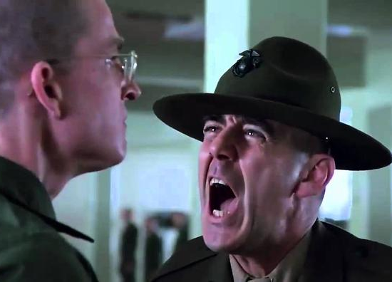
Why Mentor and not Manage?
It is about inspiring, not ordering
Understand the 5 Bases of Power
Coercive Power
Reward Power
Legitimate Power
Expert Power
Referent Power
Understand the limitation of that power
Then ask….
How do I see my vision through?
Notes:
In the military, the model for I/O psychology was born. All five bases of power exist, and are exploited, to accomplish the mission. In TAL, there is no real coercive power (the “or else” power). There is no legitimate power (promotion warrants enforced by UCMJ and or/federal law), and only limited Reward power (you cannot always monetize or incentivize excellence). You are left to promote change and excellence using Expert Power and Referent Power. Referent Power is that power that is bestowed upon you BY your people because they believe in you! That expert power is gained by people viewing you as “an expert.”

Slide 8
How do we begin a mentoring program?
Step 1:
IDENTIFY YOUR CAPABLE MENTORS
Who would you like to see replicated?
Notes:
This is crucial. A capable mentor is most often selfless, honest, charismatic, smart, loyal (EMPHASIZE LOYAL), tempered, patient, and resonates conviction in purpose. Humility is often the first sign of the right person. In the end, they want to develop people who are “BETTER THAN THEM.” Be careful of giving too much credit to the “one uppers,” “recognition seekers” and “sea lawyers.”

Slide 9
How do we begin a mentoring program?
Step 2:
Organize them; sell them; exploit them
Give them a mission (task and purpose), sponsorship/responsibility and let them go!
Notes:
First, get the right people “on the bus.” Then, inspire them to action by explaining the relevant features and benefits of a solid mentorship program. Once you have hooked them, engage their unique talents. We know that veterans love to rally around a “Challenge” and love to fulfill “a mission.” Use that to your advantage

Slide 10
How do we begin a mentoring program?
Step 3:
Idealize the tactical, operational, and strategic goals and vision for the future
Paint the vision of what a possible future will look like by replicating excellence
Notes:
It is important for visionaries to romanticize what the organization “could be” if perfect. This allows for the aligning of focus in the pursuit of perfection. Perfection never comes to fruition, but the journey toward it makes things better, and better, and better with each passing generation. The pursuit of perfection also allows the organization to adapt to change faster

Slide 11
How do we begin a mentoring program?
Step 4:
Formalize the process of the informal practice
Set timelines and goals for the mentor and mentee (a progress matrix)
Notes:
Determine the “Mission, Vision, and Values” of the mentorship program—ensure that it supports the tactical, operational, and strategic plan. Design a routine (meetings and procedures; social gathering; unique social media sub-groups; responsibilities; reporting, etc.) that will allow you to see who is “hungry” to participate. Most importantly, do NOT assign mentors to mentees or vice versa.

Slide 12
How do we begin a mentoring program?
Step 5:
Enable a Mentoring CONNECTION
Assign tasks and responsibilities based on both the mentor and mentee’s talents
Notes:
See definition on next slide

Slide 13
Definition of a Mentoring Connection
A voluntary professional association between a Mentor and Mentee. It may be of long or short duration, be conducted in person or by any form of communication
Notes:
Once you identify your talent, you find a way to conveniently group them together (off sight luncheons, field trips, additional meetings, team-building exercises, and family involvement events). Treat them as elite and they will become elite. Once they do, within the limitations of a “formalized mentorship” program, then they will blossom together based on intangible traits and characteristics…and alignment to a cause.

Slide 14
How do we begin a mentoring program?
Step 6:
Implement the program and let it flourish
Notes:
There are limitation of control in a mentorship program. Just like leadership, mentorship can be positive or negative. Positive mentorship focuses on improving the status quo and building on success. Negative mentorship involves the focus on past and present failures. You will find that with any mentorship program, both will exist all around you. This is why it is important to avoid mandating the mentor/mentee relationships or limiting them to positional mentorship only.

Slide 15
Why Mentor?
Tactical
Operational
To encourage broader participation in the community
To encourage the growth of new leaders and new ideas
To create opportunity for leaders to rise to positions of greater influence
Increase membership by promoting and proving a willingness to evolve
To prevent the canceling of existing programs
To foster the development of new programs

Slide 16
Why Mentor? STRATEGIC
Enforcement and validation of the Four Pillars!
To forever preserve and protect the life and integrity of this great organization that you have devoted many years of your own existence to
Notes:
This isn’t just about “saving The American Legion,” it’s about making it better, and better, every single day. By maintaining the health of the organization (getting rid of cancer and toxic blood; refreshing the brain with constant knowledge; remaining active in every sense), we ensure longevity. When we let cancer “dig in,” become sedentary on our humps at the bar instead of active on the streets, then we start the countdown to the end.

Slide 17
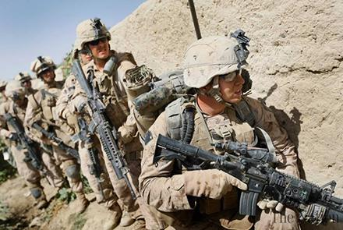
Know your Future Leaders….
Gulf War/ Global War on Terrorism eligible veterans ARE your replacements!
28-years of concurrent eligibility
The older among them are Gen X
The younger among them are Millennials

Slide 18
Generation X (1965-1980)
Who They Are
How to Exploit their Talent
They like clearly defined goals and expectations
Brand Loyalty is HUGE
Tech savvy
They have genuine concern for the customer experience
Work/life balance is MOST important
Pragmatic; results driven; self-starters
Independent; crave independence
Confident
Antiestablishment mentality
Align them to MVV’s and let ‘em go
Define TAL brand, and they will sell it
Engage by digital means
Place them in customer-facing roles
Value their family and time well
Challenge them to do the impossible (they will)
Never micro or macro manage them
“Because I said so” will fail every time

Slide 19
Generation Y “Millennials” (1981-2000)
Who They Are
How to Exploit their Talent
Driven by achievement (WIFM?)
Highly diverse with high morals
Extremely tech savvy
Ambitious, but not always focused
Fiercely independent
“Me first” attitude in work/life
Respect for competency NOT title
Patriotic, but also a global mentality
10% loyal to work; 90% loyal to life
Have an excellent awards and recognition program
Avoid “the way it was” conversations, especially with diversity topics
Allow them to develop ambitious plans, and assist them in executing (they are not doers)
Value their morals, ethics, feelings, and emotions
Never play the title game! Show them you’re a leader, don’t tell them you are!
Make things fun and engaging (worth their time). Boring ceremonies and over-use of formalities will scare them off

Slide 20
Mentorship
The Art of Inspiring, Teaching, and Training an All-Volunteer team
Thank you!
Notes:
The End

